Slide 1
Stack & Queue Applications
Course Code: CSC 2106
Course Title: Data Structure (Theory)
Dept. of Computer Science
Faculty of Science and Technology
Lecturer No: | 4.2 | Week No: | 4 | Semester:
Lecturer: | Name & email

Slide 2
Lecture Outline
Applications of Stack & Queue
Algebraic Expression
Infix, Postfix, Prefix
Infix
Operator Precedence and Associativity
Infix Expression is Hard to Parse
Examples of Infix to Postfix & Prefix
Parentheses Check Using Stack
Converting Postfix Expression Using Stack & Queue
Evaluating Postfix Expression Using Stack & Queue
Books
References

Slide 3
Applications of Stack & Queue
Syntax parsing, Parenthesis check [Stack]
Expression evaluation and Expression conversion. [Stack & Queue] [Can also be achieved using only Stack]
Banking Transaction View [Stack]
You view the last transaction first.
Backtracking and implementation of recursive function, calling function. [Stack]
Towers of Hanoi [Stack]
Keeping Track of Printing Jobs [Queue]

Slide 4
Algebraic Expression
An algebraic expression is a legal combination of operands and the operators.
Operand is the quantity (unit of data) on which a mathematical operation is performed.
Operand may be a variable like x,y,z or a constant like 5,4,0,9,1 etc.
Operator is a symbol which signifies a mathematical or logical operation between the operands. Example of familiar operators include +,-,*,/,^,%
Considering these definitions of operands and operators now we can write an example of expression as: x + y * z

Slide 5
Infix, Postfix and Prefix Expressions
INFIX: The expressions in which operands surround the operator, i.e. operator is in between the operands. e.g. x+y, 6*3 etc. The infix notation is the general way we write an expression.
POSTFIX: Also Known as Reverse Polish Notation (RPN). The operator comes after the operands, i.e. operator comes post of the operands, so the name postfix. e.g. xy+, xyz+* etc.
PREFIX: Also Known as Polish notation. The operator comes before the operands, i.e. operator comes pre of the operands, so the name prefix. e.g. +xy, *+xyz etc.

Slide 6
Infix
To our surprise INFIX notations are not as simple as they seem specially while evaluating them. To evaluate an infix expression we need to consider Operators’ Precedence and Associative property
For example expression 3+5*4 evaluate to
32 = (3+5)*4
or
23 = 3+(5*4)
Operator precedence and associativity governs the evaluation order of an expression.
An operator with higher precedence is applied before an operator with lower precedence.
Same precedence order operator is evaluated according to their associativity order.

Slide 7
Infix
To our surprise INFIX notations are not as simple as they seem specially while evaluating them. To evaluate an infix expression we need to consider Operators’ Precedence and Associative property
For example expression 3+5*4 evaluate to
32 = (3+5)*4 - Wrong
or
23 = 3+(5*4) - Correct
Operator precedence and associativity governs the evaluation order of an expression.
An operator with higher precedence is applied before an operator with lower precedence.
Same precedence order operator is evaluated according to their associativity order.

Slide 8
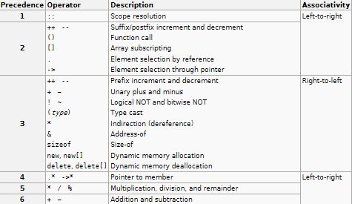
Operator Precedence and Associativity

Slide 9
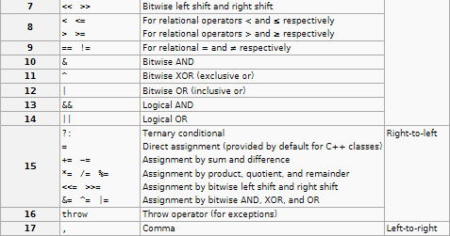
Operator Precedence and Associativity

Slide 10
Infix Expression Is Hard To Parse
Need operator priorities, tie breaker, and delimiters.
This makes the evaluation of expression more difficult than is necessary for the processor.
Both prefix and postfix notations have an advantage over infix that while evaluating an expression in prefix or postfix form we need not consider the Precedence and Associative property.
The expression is scanned from user in infix form; it is converted into prefix or postfix form and then evaluated without considering the parenthesis and priority of the operators.
So, it is easier (complexity wise) for the processor to evaluate expressions that are in these forms.

Slide 11
Examples of infix to prefix and postfix
Infix | PostFix | Prefix
A+B | AB+ | +AB
(A+B) * (C + D) | AB+CD+* | *+AB+CD
A-B/(C*D^E) | ABCDE^*/- | -A/B*C^DE
A
-
B
/
(
C
*
D
^
E
)
A
B
C
D
E
^
*
/
-
-
A
/
B
*
C
^
D
E
A
-
B
/
(
C
*
F
)
A
B
C
F
*
/
-
D
^
E
-
A
/
B
*
C
F
D
^
E
A
-
B
/
G
A
B
G
/
-
C
*
F
-
A
/
B
G
C
*
F
A
-
H
A
H
-
B
/
G
-
A
H
B
/
G
I
I
A
-
H
I
A
-
H

Slide 12
Parentheses Check Using Stack
Using Stack, we can check whether an expression has its parenthesis properly placed; i.e., whether its opening and closing parentheses match with each other. For example, let’s take the expression (x{x[]}x)
We will read the expression as a string and for each character we will do the following three things:
Whenever we get an opening parenthesis, we will push it into the stack.
When we get a closing parenthesis we will check that with the top of the stack. If the top of the stack has the same type of opening parenthesis, we will pop it.
We skip the character in the string which is not a parenthesis.
Finally if you have reached the end of the expression and the stack is also empty, that means the expression is “well formed”. In any other case, the expression is “not well formed”.

Slide 13
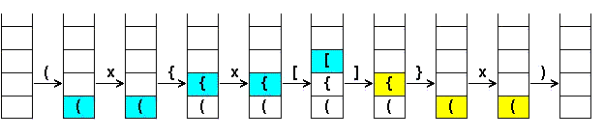
Parentheses Check Using Stack
(x{x[]}x)
We will read the expression as a string and for each character we will do the following three things:
Whenever we get an opening parenthesis, we will push it into the stack.
When we get a closing parenthesis we will check that with the top of the stack. If the top of the stack has the same type of parenthesis but an opening one, we will pop it.
We skip the character in the string which is not a parenthesis.
This expression is
“well formed”

Slide 14
Infix to Postfix Conversion - Algorithm
Create an empty stack and an empty postfix output string/stream
Scan the infix input string/stream left to right
If the current input token is an operand, simply append it to the output string
If the current input token is an operator, pop off all operators that have equal or higher precedence and append them to the output string; push the operator onto the stack. The order of popping is the order in the output.
If the current input token is '(', push it onto the stack
If the current input token is ')', pop off all operators and append them to the output string until a '(' is popped; discard the '('.
If the end of the input string is found, pop all operators and append them to the output string.

Slide 15
Infix to Postfix Conversion
Infix: a + ( b + c ) * d – e * f
Symbol | Stack | Postfix
a |  | a
+ | + | a
( | + ( | a
b | + ( | a b
+ | + ( + | a b
c | + ( + | a b c
) | + | a b c +
* | + * | a b c +
d | + * | a b c + d
- | - | a b c + d * +
e | - | a b c + d * + e
* | - * | a b c + d * + e
f | - * | a b c + d * + e f
 |  | a b c + d * + e f * -

Slide 16
Infix to Postfix Conversion: Example
Infix:
Postfix:
Stack:
a + ( b + c ) * d – e * f
a
b
c
+
d
*
+
e
f
_
*
+
(
+
*
-
*

Slide 17
Converting Infix to Postfix Using Stack & Queue
Infix Expression: 2*6/(4-1)+5*3
Add ')' to the end of Infix; Push( '(' );
do{
OP = next symbol from left of Infix;
if OP is OPERAND then EnQueue( OP );
else if OP is OPERATOR then{
if OP = '(' then Push( OP );
else if OP = ')' then{
while TopElement() != '(' do{
Enqueue(TopElement());
Pop();
}
Pop();
}else{
while Precedence( OP ) <= Precedence( TopElement() ) do{
Enqueue(TopElement());
Pop();
}
Push( OP );
}
}while !IsEmpty();
)
+
2
4
-
)
+
2
4
-
1
/
1
Infix
*
6
/
(
*
6
(
Postfix
2
6
*
4
1
-
/
5
3
*
+
Stack
(
+
*
/
(
*
-
OPERATOR
OPERAND
End of Expression
/ = StackTop( * )
* ≥ StackTop( ( )
/ ≥ StackTop( ( )
(
)
+ < StackTop( / )
+ ≥ StackTop( ( )
* ≥ StackTop( + )
- ≥ StackTop( ( )

Slide 18
Evaluating Postfix Expression Using Stack & Queue
Postfix Expression: 26*41-/53*+
EnQueue( ')' );
while ( FrontElement() != ')' ) do{
OP = FrontElement();
DeQueue();
if OP is OPERAND then Push( OP );
else if OP is OPERATOR then{
OperandRight = TopElement();
Pop();
OperandLeft = TopElement();
Pop();
x = Evaluate(OperandLeft, OP, OperandRight);
Push(x);
}
}
Result = TopElement();
Pop();
cout << Result;
6
6
*
*
4
4
1
1
-
-
/
/
5
5
3
3
*
*
+
+
)
2
)
Postfix
2
Stack
2
6
1
12
4
19
4
3
5
15
3
OPERATOR
OPERAND
Evaluate( 2, '*', 6 ) = 12
Evaluate( 4, '+', 15 ) = 19
‘)‘
Evaluate( 5, '*', 3 ) = 15
Evaluate( 12, '/', 3 ) = 4
Evaluate( 4, '-', 1 ) = 3
End of Expression
Expression Result = 19

Slide 19
Stack Applications
Evaluation of Postfix Expression - Algorithm
1) Create a stack to store operands (or values).
2) Scan the given expression and do following for every scanned element.
…..a) If the element is a operand, push it into the stack
…..b) If the element is a operator, pop operands for the operator from stack. Evaluate the operator and push the result back to the stack
3) When the expression is ended, the number in the stack is the final answer

Slide 20
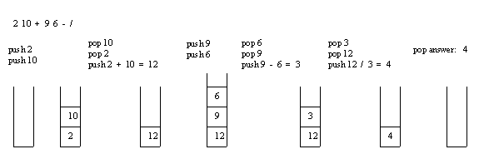
Stack Applications
Evaluation of Postfix Expression (Example)

Slide 21
Stack Applications
Evaluation of Postfix Expression (Example)
Expression: 6 5 2 3 + 8 * + 3 + *

Slide 22
Books
“Schaum's Outline of Data Structures with C++”. By John R. Hubbard
“Data Structures and Program Design”, Robert L. Kruse, 3rd Edition, 1996.
“Data structures, algorithms and performance”, D. Wood, Addison-Wesley, 1993
“Advanced Data Structures”, Peter Brass, Cambridge University Press, 2008
“Data Structures and Algorithm Analysis”, Edition 3.2 (C++ Version), Clifford A. Shaffer, Virginia Tech, Blacksburg, VA 24061 January 2, 2012
“C++ Data Structures”, Nell Dale and David Teague, Jones and Bartlett Publishers, 2001.
“Data Structures and Algorithms with Object-Oriented Design Patterns in C++”, Bruno R. Preiss,

Slide 23
References
http://www.cs.uregina.ca/Links/class-info/210/Stack/
http://www.cs.csi.cuny.edu/~zelikovi/csc326/data/assignment5.htm

